Slide 1
2021 MA Public Higher Education Trustee Convening
October 27, 2021

Slide 2
What is the Equity Agenda?
The Equity Agenda
Development of the Equity Agenda:
Lumina Foundation and the Talent, Innovation, and Equity (TIE) designation
National designation as “highly educated state”: Percent of population 25-64 with a post-secondary degree, or certificate
Why focus on racially minoritized populations? Economics, Democracy, and Social Justice
What makes the Massachusetts approach rather unique? System-wide, Targeted, and requires Internal Professional Development

Slide 3
Equity Agenda Overview
Equity Agenda
The Equity Agenda outlines an action plan that covers five key areas:
Policy Audit
  Complete a Department-wide policy audit to assess all policies and initiatives
  Identify and remove policies that exacerbate racial inequity
  Redesign the Department’s policy scheme to build a culturally sustainable public postsecondary system where students can thrive
Student Experience
  Reimagine the undergraduate experience in order to dismantle systemic barriers by recognizing students’ cultural wealth and transforming teaching and learning (New Undergraduate Experience)
  Align system and institutional efforts to create student-ready campuses
Data and Evidence
  Expand data dashboards to measure progress toward the goal of racial equity and include baseline projections and benchmarks of Massachusetts public higher education enrollment through 2030
  Value students’ experiences through qualitative research
  Identify and support the implementation of equity-minded, evidence-based solutions
Community of Practice
  Support the growth of a system-wide community of practice
  Elevate the work of equity leaders
  Create digital resources for campuses, which may include implementation toolkits and digital archives to allow sharing across campuses
  Develop a statewide professional development curriculum focused on culturally sustaining teaching practices
Sustained Transformation
  Convene and support a broad coalition of equity partners
  Develop a 10-year statewide strategic plan focused on advancing racial equity

Slide 4
FY22 Policy Priorities

Slide 5
FY22 Policy Priorities
Equity Agenda
Equity Agenda
FY22 Priorities
SAT Optional Pilot
Developmental Education
Strategic Finance
MassGrant Plus
Early College

Slide 6
Expand Early College

Slide 7
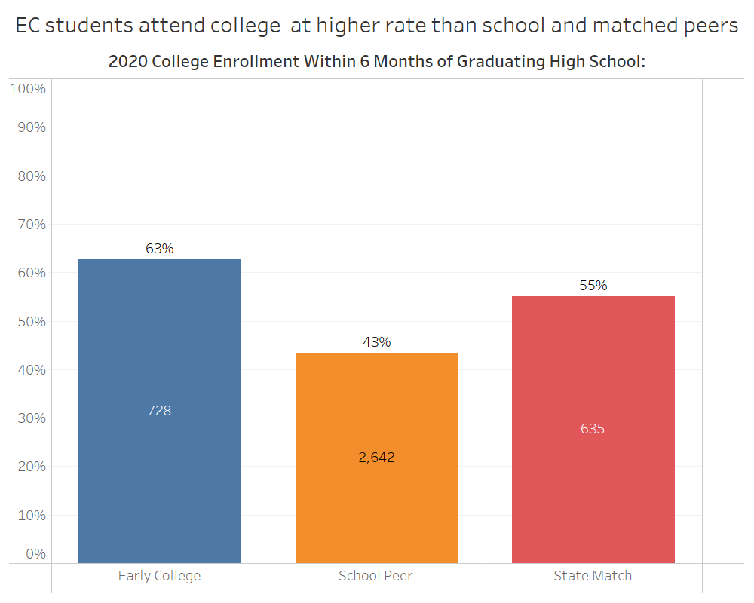
EC increases college attendance
Equity Agenda FY22 Priorities
Source:
National Student Clearinghouse
Notes:
EC has shown significant increase in college attendance for students as compared to the peers in their own school, and with regards to similarly situated students across the state.

Slide 8
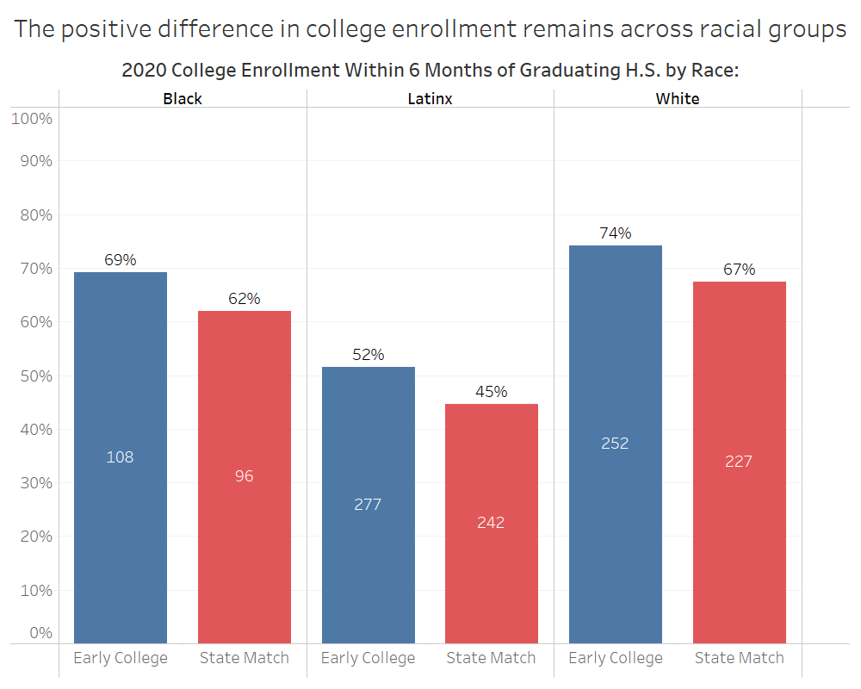
Outcomes consistent by race
Equity Agenda FY22 Priorities
Source:
National Student Clearinghouse
Notes:
EC has consistently shown positive outcomes across racial groups.

Slide 9
Legislative Investment FY22
Equity Agenda FY22 Priorities
Significant Increase in EC Funding
DHE: CDEP line increase of $5M for EC courses
EOE: Early College line doubled in funding to $5M
DESE: EC is a focus of significant federal and state K-12 investments/ESSER funds

Slide 10
FY22 Strategy
Equity Agenda – FY22 Priorities
Continue to support sustainability and growth of existing programs through extensive technical support and community of practice
Continue to support internal capacity to grow the community of practice, data analysis, and program evaluation.
Continue to support prospective programs.
Continue to support implementation of new programs.
Support Early College innovation, growth, and improvement
  Benchmarking Study to identify long-term expansion constraining factors and opportunities
  Invest resources in existing programs to increase scale
  Invest resources to support planning of large scale immersive early college models

Slide 11
SAT Admissions Requirement: From Pilot to Policy

Slide 12
Test Policies
Equity Agenda – FY22 Priorities
Test required
SAT/ACT required for admission
Test optional
SAT/ACT not required for admission but may be submitted for consideration
Test flexible
Other standardized test score may be submitted in lieu of SAT/ACT (e.g., SAT subject test)
Test free
Standardized test scores not accepted for consideration for admission
Notes:
Postsecondary institutions nationwide consider standardized tests in different ways for both admissions purposes and course placement, falling into one these categories. Historically, institutions have largely required test scores for admissions, but many have reconsidered their positions in light of the research indicating that testing serves more as a barrier to success than as a barometer of future achievement.
[1] https://blog.collegeboard.org/what-is-a-test-optional-college
[2] https://www.insidehighered.com/admissions/article/2021/05/17/u-california-will-not-consider-sat-or-act-scores-future
[3] https://www.ihep.org/wp-content/uploads/2021/06/IHEP_JOYCE_full_report_final_web_614.pdf (p. 51 also covers the types of policies and uses “test free” which, from a language standpoint, may be more inclusive than the colloquial “test blind”)

Slide 13
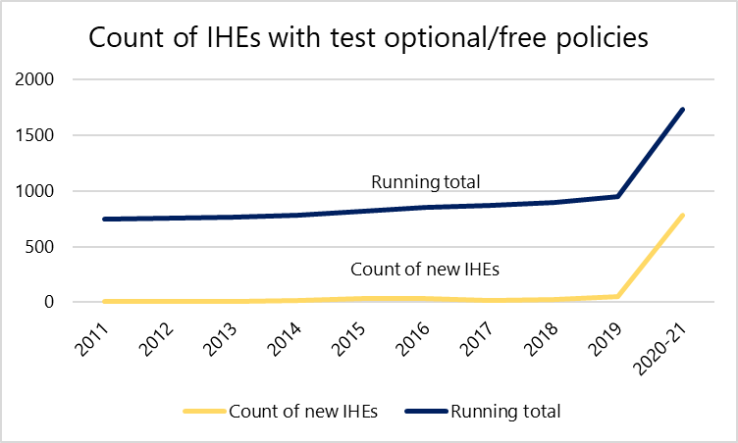
Nationwide Policy Adoption 2011-21
Equity Agenda – FY22 Priorities
Source: FairTest National Center for Fair & Open Testing.
Notes:
And, as we can see by this sharp uptick in 2020-21, postsecondary institutions instituted these policies on a much broader basis since the onset of the COVID-19 pandemic, which disrupted the test-taking ecosystem, both by causing widespread cancelations of test administrations, as well as decreasing the availability of accommodations for students that require them.
[1] For growth over time: https://www.fairtest.org/sites/default/files/Optional-Growth-Chronology.pdf
[2] For total: https://fairtest.org/university/optional/state (copy/pasted list into Excel, ran count)
(Last updated 9/15/21)

Slide 14
MA Test Optional Pilot
Equity Agenda – FY22 Priorities
All baccalaureate institutions have now implemented the test optional pilot
AY2016
AY2017
AY2018
Salem
UMass Lowell
Bridgewater
MassArt
UMass Boston
Fitchburg
Worcester
AY2019
UMass Dartmouth
AY2020
MCLA
Westfield
UMass Amherst (spring only)
Framingham
Mass Maritime (spring only)

Slide 15
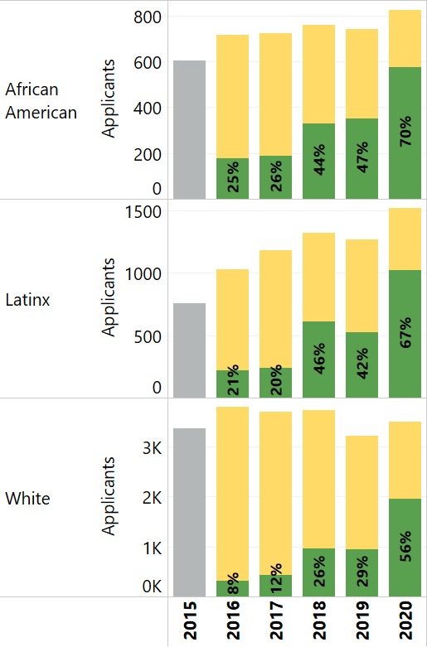
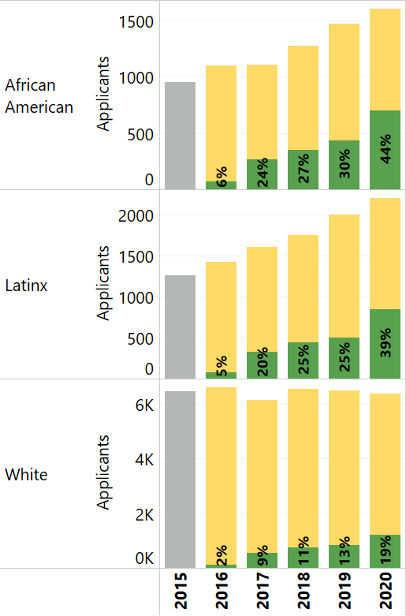
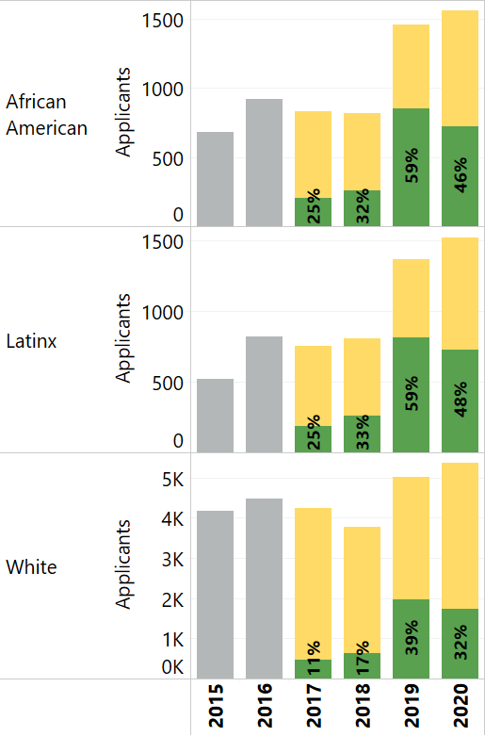
MA SAT Optional Pilot Programs
Equity Agenda – FY22 Priorities
Looking at three institutions with more mature pilots, total applications are up significantly among African American and Latinx students in many cases, and the share of students choosing not to submit scores (green) is also increasing:
Salem State
UMass Lowell
Bridgewater State
Source: Massachusetts Department of Higher Education (HEIRS)
Notes:
In addition to what is pictured here, representation of Black and Latinx students in each institution’s applicant pool is also increasing. From 2017 to 2020, taking Black and Latinx students as one group:
Representation among Bridgewater State applicants increased from 23% to 30%
Representation among UMass Lowell applicants increased from 23% to 27%
Representation among Salem State applicants increased from 29% to 33%

Slide 16
Increase Affordability

Slide 17
FY22 Areas of Priority – Financial Aid
Equity Agenda
College Affordability: Closing the Unmet Need Gap
MASSGrant Plus
  Continue funding MASSGrant Plus for community college students
    Provides resources for tuition/fees and modest book allowance
    Data shows modest gains in reduction of unmet need – attributable to MASSGrant Plus (and perhaps other factors)
      24% of eligible students with unmet need in FY18
      21% of eligible students with unmet need in FY19
      16% of eligible students with unmet need in FY20
  Expand MASSGrant Plus to State University Students
    Prioritize MASSGrant Plus for Pell Eligible students
    Last dollar award for direct costs (tuition/fees, books & supplies)
    FY20 unmet need for Pell eligible students exceeded $18 million
    Proposed $10m appropriation could substantially impact unmet need

Slide 18
Increase Affordability
Proposed $10m increase in MassGrant Plus appropriation for state university students would substantially reduce unmet need
For Pell-eligible state university students, $10m would have reduced total unmet need (on tuition, fees, books & supplies) by:
55% in 2018
48% in 2019
53% in 2020
Source: Massachusetts Department of Higher Education (HEIRS)

Slide 19
Eliminate Non-credit Bearing Standalone Developmental Education Courses

Slide 20
Eliminate Non-credit Bearing Standalone Developmental Education Courses
Equity Agenda – FY22 Priorities
Nationally, institutions are more likely to place Black and Latinx students into developmental education
  Students in developmental education are more likely to be impacted by negative outcomes including financial cost of courses not tied to a degree, delayed access to credit-bearing courses, and stigma that a student is “not ready” for college.
Reforms that have taken place nationally and in Massachusetts include co-requisite courses, course placement using multiple measures instead of relying on one standardized test.

Slide 21
MA’s Three-Pronged Approach
MA’s Three-Pronged Approach
Multiple Assessment & Placement Measures
Mathematics Pathways
Co-requisite Support
Developmental Education
Early data from a DHE assessment for revised placement policy indicates that, in 2019, completion rates for Black and Latinx students in gateway, credit-bearing math and English courses jumped five percentage points.

Slide 22
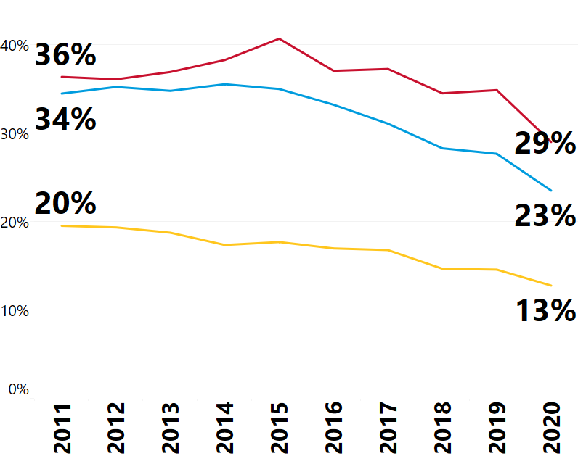
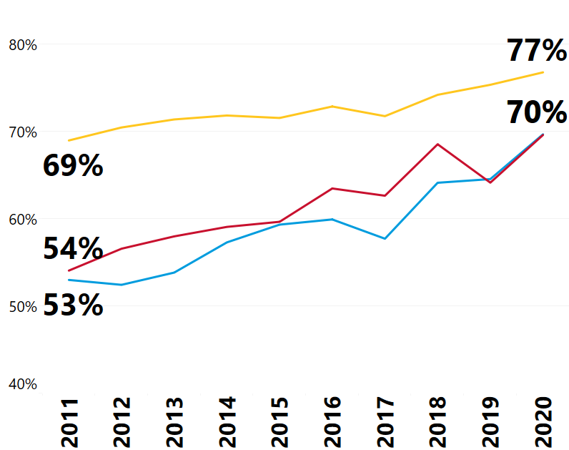
Eliminate Non-credit Bearing Standalone Developmental Education Courses
Equity Agenda – FY22 Priorities
Community Colleges—Enrollment in English in first year (full-time students)
Enrollment in Developmental English
Enrollment in College-Level English
Source: Massachusetts Department of Higher Education (HEIRS)
Notes:
Regarding Developmental English: This includes both pre-requisite and co-requisite enrollment. A smaller share of students are being placed into developmental, and of those who are placed in developmental, a growing share are in co-req frameworks, which is one reason why we are seeing substantial increases in college-level course enrollment. In the most recent year, 45% of African American, 61% of Latinx, and 66% of White students placed into developmental English were in co-req frameworks.

Slide 23
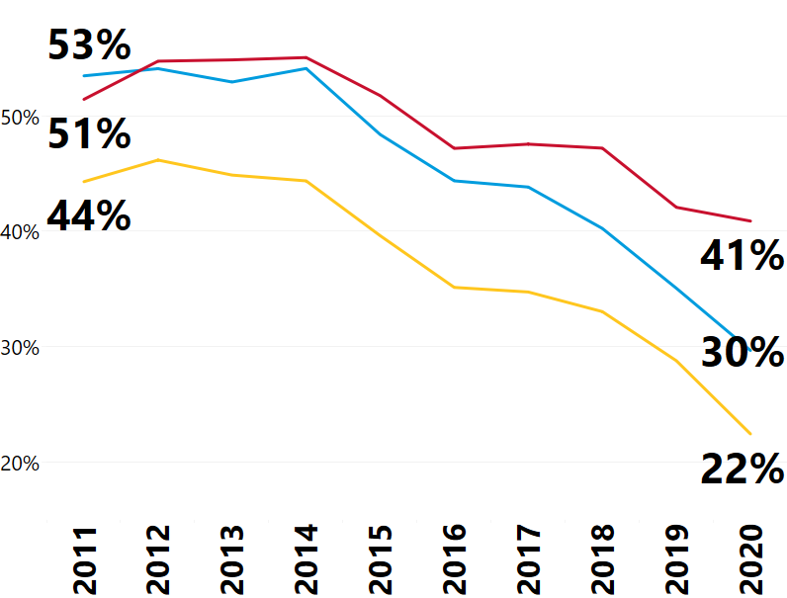
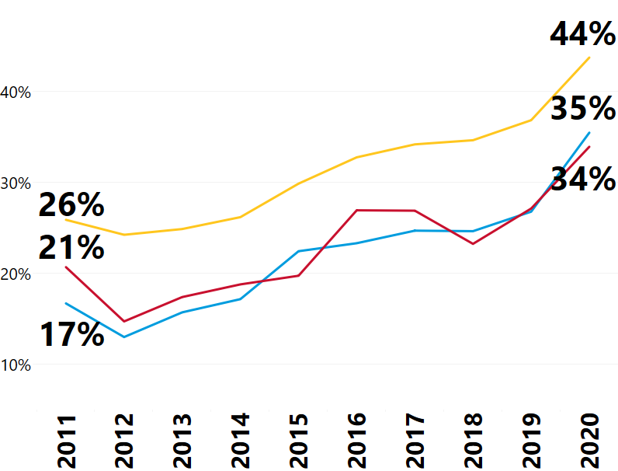
Eliminate Non-credit Bearing Standalone Developmental Education Courses
Equity Agenda – FY22 Priorities
Community Colleges—Enrollment in math in first year (full-time students)
Enrollment in Developmental Math
Enrollment in College-Level Math
Source: Massachusetts Department of Higher Education (HEIRS)
Notes:
Regarding Developmental Math: Same explanation as English (previous slide), but co-req frameworks are not as widely used for developmental math students. In the most recent year, 23% of Latinx, 26% of White, and 29% of African American students placed into developmental math were in co-req frameworks. In addition to growth in co-req remediation, implementation of the Common Assessment Policy and Math Pathways in recent years have contributed to the increasing numbers of first-year students enrolling in college-level math.

Slide 24
Next Steps
Equity Agenda – FY22 Priorities
Revive the statewide Developmental Education Advisory Board and charge the group to partner with DHE staff to develop an equity-minded policy to eliminate standalone non-credit bearing developmental education courses.
Develop equity-minded implementation guidelines once policy is adopted by the Board.
Refine success metric to better track progress.

Slide 25
Strategic Finance

Slide 26
FY22 Areas of Priority – Finance
Equity Agenda
  Formula Funding (Section 15b of MGL Chapter 15a)
  Funded at 2% of college and university base appropriations for second consecutive fiscal year.
  $5.8M and $6.3M for the SU and CC segments, respectively
  FY21 distributions ranged between 1.5% and 2.5% of line-item funding
  Opportunity to more closely align base budget and outcome metrics with Equity principles and goals

Slide 27
FY22 Areas of Priority – Finance
Equity Agenda
  BHE budget recommendations for FY21 cited commitment to a strategic approach to funding public higher education – delayed due to pandemic
  Public investment in higher education should be aligned with and supportive of the Equity Agenda and promote innovation, efficiency, and student outcomes.
  Opportunity in FY22 to study and recommend a strategic funding framework that aligns with the BHE’s values and vision for the future of higher education in Massachusetts

Slide 28
FY22 Areas of Priority – Finance
Equity Agenda
  Strategic Review of Public Higher Education Financing
  RFR issued to solicit proposals from experienced consultants to:
  Provide a current state review and analysis of how public higher education in Massachusetts is financed
  Provide a comparative analysis with other states
  Provide analyses of the potential impacts of demographic changes, COVID-19 and federal policy changes
  Provide initial findings and final report on analysis of student-level impacts
  Provide initial findings and final report on analyses of how alternative approaches might impact students, campuses, the workforce and the Commonwealth

Slide 29
Strategic Plan for Racial Equity

Slide 30
Development of the Strategic Plan
The Strategic Plan will be developed in partnership with all the Commonwealth’s key stakeholders and using the inputs outlined below:
Environmental Scan
System-Wide Data Analysis
System-Wide Survey
Stakeholder Interviews and Focus Groups
Stakeholder Input via Strategy Labs & Review Sessions
Leading Best
Practices
NUE Report
Statewide Strategic Plan for Racial Equity

Slide 31
Strategic Plan for Racial Equity Deep Dive
Equity Agenda: Strategic Plan for Racial Equity Update
The Strategic Plan for Racial Equity will be developed in partnership with all the Commonwealth’s key stakeholders using the inputs below:
System-Wide Survey
Interviews and Focus Groups
Strategy Lab Sessions
Plan Review Sessions
This survey aims to gather sentiment data from stakeholders across all 28 undergraduate institutions. Students will be asked about their experiences across their learner journey while staff, faculty, and administrators will be asked about equity-leading practices and the extent to which they feel that they have equitable experiences at their institution.
Participants: Students, Staff, Faculty, and Administrators
Interviews and focus groups with the Board, DHE, and representatives across all institutions will provide more nuanced insights into racial equity challenges across the system. Discussions will also cover what success of the strategic plan should look like and implementation considerations.
Participants: Board members, DHE representatives, Trustees, and a selection of presidents, CAOs, CSAOs, CFOs, CDOs, faculty, and students
Strategy lab sessions will include 20-25 stakeholders across the public higher education system. The goals of the sessions are to begin to craft the vision, mission, goals, and initiatives that will be incorporated in the Strategic Plan using quantitative and qualitative data to drive decision-making.
Participants: Representatives from the Board, DHE, institutions, and industry
After the development of a draft Strategic Plan, fifteen two-hour review sessions will be conducted with stakeholders from across the system including faculty, students, staff, administrators, DHE, and the full Board. Feedback from all review sessions will be incorporated into the final Strategic Plan.
Participants: Representatives from the Board, DHE, and all institutions
In addition, the DHE is working with Deloitte to conduct a series of data collection efforts from the institutions and data analyses to further understand racial equity-related trends across the system.

Slide 32
WE WANT TO HEAR FROM YOU!
Department of Higher Education will release a survey designed for local trustee input.
What do you believe are racial equity-related strengths within the Commonwealth’s public higher education system that should be preserved? What are racial equity-related strengths at your institution (e.g., programs, committees, etc.)?
What are the most pressing racial equity-related challenges across the system that should be addressed? What are racial-equity related challenges at your institution (e.g., enrollment, hiring faculty and staff of color, etc.)?
What needs to be included in the 10-year Statewide Strategic Plan for Racial Equity for the plan to be successful?

